Slide 1
Geostationary Station-Keeping with Reinforcement Learning
Interns: Erik Magnusson, Brian Druby, Oliver Luo
Mentors: Jim Zapata, Rich Osedacz, Michelle Stephens
9 August 2021
Notes:
Erik

Slide 2
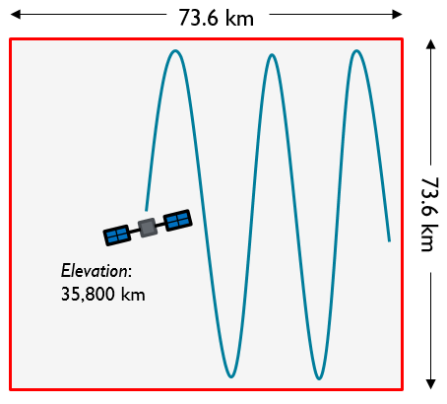
Project Objective
Reinforcement Learning Agent
Orbit Propagator
Environment
What:
Discover a more efficient station-keeping policy for geostationary satellites
Why:
Regulations require satellites to stay within a predefined area but the methods for doing so may have room for fuel-efficiency improvement
How:
Create a 2D environment that reflects the conditions of a constrained geostationary orbit
Use reinforcement learning to discover a more efficient maneuver policy through trial and error
Final Outputs:
A model capable of learning a near-optimal maneuver policy
State &
Reward
Action
State
Notes:
Erik
- Better fuel-efficiency = extended lifespan = more money

Slide 3
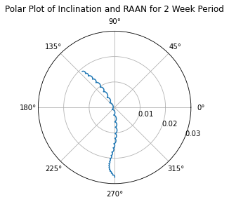

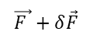
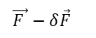
Lunisolar Gravity Effect – N/S Station-keeping
The sun and moon produce gravitational forces that torque the orbit
Affects RAAN and inclination – North/South station-keeping
Modeled as Third Body Attractions
Direction of Sun/Moon
$$\vec{F }−δ\vec{F}$$
$$\vec{F }+δ\vec{F}$$
Inclination
Notes:
Brian
Lunisolar Gravity Effect
The sun and moon are not in the earth’s equatorial plane
This creates an out-of-plane force that torques the orbit of a geostationary satellite: changing both the RAAN and the inclination
Using OREKIT, this can be modeled as third body attractions producing the polar plot in the lower right hand corner
If an orbit begins with RAAN = 270, the inclination will initially decrease, reach a minimum, then increase again
The small peaks and troughs are the result of daily solilunar effects
The total amount of delta V needed to counteract lunisolar gravity is approximately 46 m/s each year (it varies depending on the year)

Slide 4
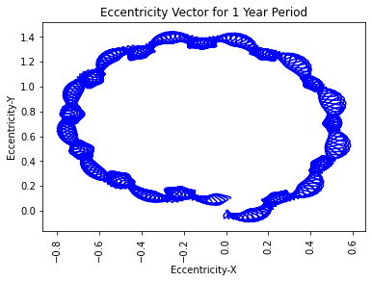
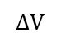
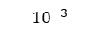
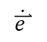
Solar Radiation Pressure – E/W Station-keeping
Solar radiation pressure produces a force that changes the magnitude and direction of the eccentricity vector
Creates a longitude libation that occupies part of the deadband
Modeled as a satellite with constant effective cross-sectional area ≈ 0.06 m²/kg
$$ΔV$$
$$\dot{\overset{⃑}{e }}$$
$${10}^{−3}$$
$$ΔV$$
$${10}^{−3}$$
Notes:
Brian
Solar Radiation Pressure
Electromagnetic radiation produces a force that perturbs the magnitude and direction of the eccentricity of a geostationary satellite
It can be approximated as two deltaVs performed when the satellite-sun line is perpendicular to the satellite-earth line
The eccentricity change creates a longitudinal libation that occupies part of the E/W deadband and therefore must be controlled
The SRP was modeled assuming a satellite of constant effective cross-sectional area
As the Earth revolves around the sun, the direction of the SRP force changes, eventually canceling out by the end of the year
This produces the year-long period depicted in the graph in the bottom right
The total delta V needed to counteract SRP is highly dependent upon the size of the deadband, the effective cross-sectional area, and the station-keeping schedule. However, it is still significantly less than N/S control.

Slide 5
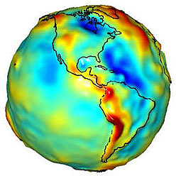
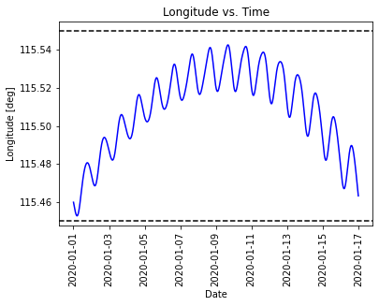
Earth’s Triaxiality – E/W Station-keeping
Earth’s non-symmetrical gravity field produces a longitudinal acceleration towards areas of high mass density (e.g. Rocky Mountains, Mt. Everest)
Over small longitude deadband it creates a near constant change in drift rate
Parameter | Value
Gravity Field | 8th Order 8th Degree
Longitude | 115.5 E
Longitude Change | -0.00199 º/day²
Notes:
Brian
Photo Courtesy of NASA GRACE Mission
Earth’s Triaxiality
The non-symmetrical gravity field of Earth produces accelerations in the longitudinal direction
The image in the top left corner visually depicts the mass distribution of the earth
The red over areas such as the Andes Mountains and the Rocky Mountain Range show higher mass density areas
The magnitude of the acceleration is dependent upon the station longitude of the satellite, however its nearly constant within a small deadband (for this case 0.00199 degrees per day squared)
This produces the quasi-parabolic curve shown in the figure on the bottom right
The total delta V needed to counteract Earth’s Triaxiality is approximately 2 m/s each year (it varies depending upon the station longitude)

Slide 6
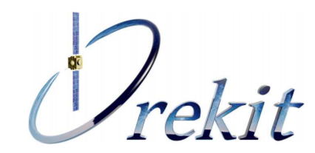
Orbit Propagator and Perturbation Modeling
Forces to be Modeled
Lunisolar Gravity
Earth’s Triaxiality
Solar Radiation Pressure
Impulsive Station-keeping Maneuvers
Information Collected
Position
Velocity
Acceleration
Mass
Notes:
Brian
All three of the previously mentioned forces, as well as impulsive station-keeping maneuvers must be accurately modeled
Orekit, a low level space dynamics library, was chosen to model these forces
It provides functionality for:
Third body attractions
Simple and complex solar radiation effects
Gravity models
Event handlers to apply impulsive maneuvers
As well as more complex maneuvers if future iterations of this project require more accuracy
It also allows easy extraction of the state information necessary to train the ML Agent including Position, Velocity, Acceleration and Mass

Slide 7
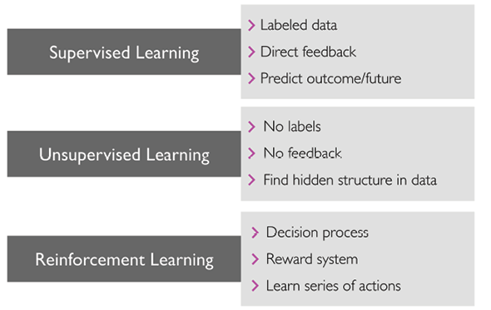
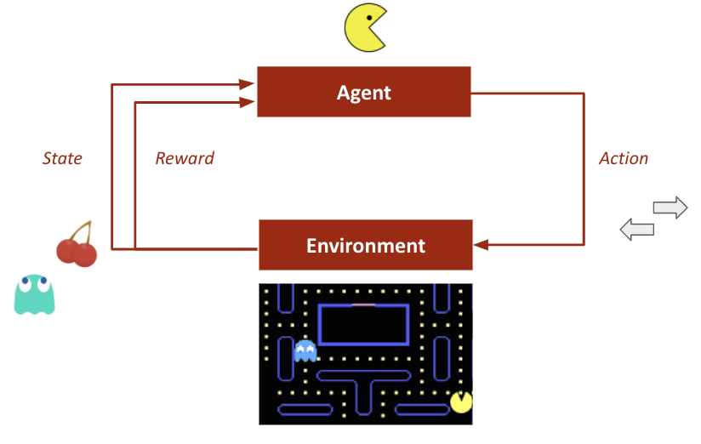
Reinforcement Learning
PAC-MAN example:
Notes:
Erik
(def) reinforcement learning: area of machine learning focused on teaching an agent to take actions in an environment using a system of positive and negative rewards (ex: autonomous vehicles, chess engines)
image sources:
https://learning.oreilly.com/library/view/python-machine-learning/9781789955750/Text/Chapter_1.xhtml#_idParaDest-22
https://towardsdatascience.com/deep-q-network-combining-deep-reinforcement-learning-a5616bcfc207

Slide 8
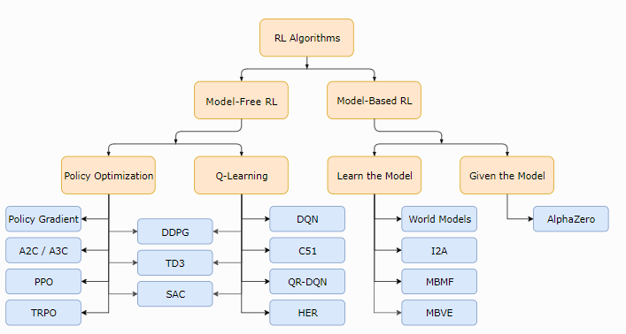
Proximal Policy Optimization (PPO)
Choosing the algorithm
Model-Free vs. Model-Based
Policy Optimization vs. Q-Learning
PPO
Supports discrete and continuous action spaces
Outperformed competing algorithms in the Lunar Lander OpenAI environment
Feature
Actor-Critic neural network structure
Actor: chooses actions
Critic: evaluates actions
Notes:
Erik
Released by OpenAI researchers in 2017
Balances ease of implementation, sample efficiency, and ease of tuning
Policy gradient method
Learns on the current policy rather than on stored values (like in Q-Learning)
Traditionally less sample efficient because each sample group is only used to train the mode once
Reasons:
Model-free over model-based
“allowing the agent to pursue a trial-and-error approach to learning an optimal policy rather than trying to hand shape it with limited background knowledge”
Would be very difficult to model the distribution of states and the environment dynamics
Policy-based methods over value-based methods
“With relatively large action and state spaces, we don’t want to store values for every State-Action combination”
“Samples are thrown away after they are used to update the current policy”
Better for high-dimensional action spaces or when using continuous actions
Value-based (e.g., DQN) can be slow bc of all the Q value calculations at each step
Automatically implements exploration/exploitation tradeoff
PPO
To avoid updates that send the agent down an unrecoverable path, with size of the policy update is limited via loss clipping

Slide 9
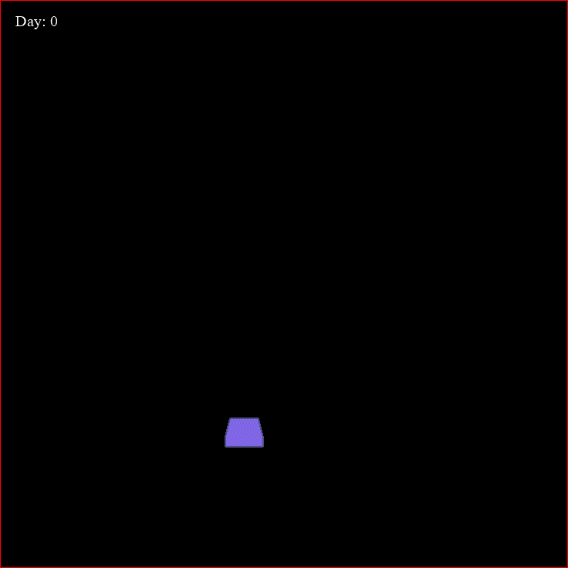
Reinforcement Learning Flow
Initialize state
Take action
Calculate new state
OREKIT
RL Agent
Actor Model
loss
Critic Model
Obtain reward
Transform state
Notes:
Erik
Overall model flow:
OREKIT initializes a new orbital state for the agent (a satellite in our case)
That state is passed to our custom environment where reward calculation and state standardization occur
Reward and standardized state are passed to the neural networks of the learning agent as inputs
Loss function updates the policy’s action probabilities based on the success of the previous action
RL agent outputs an action that is passed to OREKIT to calculate an updated state

Slide 10
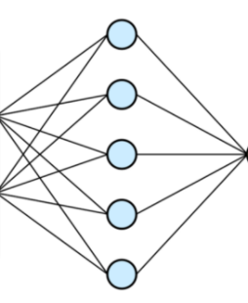
Network Structures
Actor Model
Critic Model
Do nothing
West burns
North burns
East burns
Scalar
Input state
Action Probabilities
Input state
Rating of Action Taken
Neural Network
Neural Network
Notes:
Erik
Actor Model:
Takes a 7 element state space as input and outputs a maneuver option by using the softmax function on the action probabilities
Mention lack of South thruster
Critic Model:
Learns if the action taken by the Actor led the environment to be in a better state or not (measured with Generalized Advantage Estimation or estimated future rewards)
Allows the Actor to compare its current policy with a new policy and adjust accordingly

Slide 11
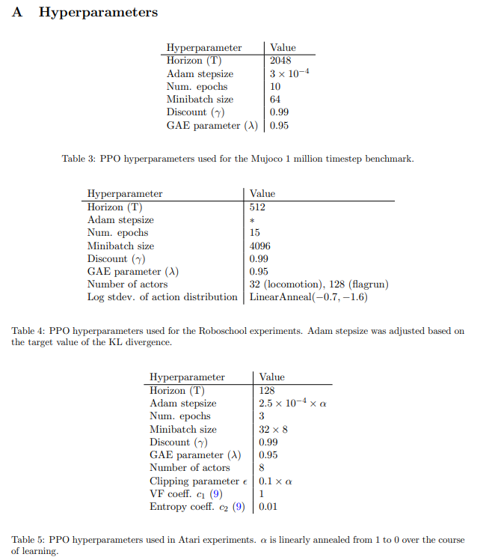
Key Parameters
Clipping (Epsilon) (0.1 – 0.3)
Limits the step size from the old policy to the new policy
Batch Size (32 – 4096)
Number of training examples passed through the neural network at once
GAE Discount Factor (Gamma) (0 – 1)
0: approximate next-step return, 1: approximate sum of all future rewards
For long episodes, we need gamma < 1 for tractability/convergence
Neural network structure
Hidden layers (1 – 3)
Nodes (32 – 512)
Learning Rate (5x10⁻⁵ to 3x10⁻³)
Controls learning rate of the optimizer (Adam, in our case)
Notes:
Erik
A higher clipping term allows for greater change between policies (more exploration, less exploitation)
A higher batch size should lead to more stable updates but learns slower

Slide 12
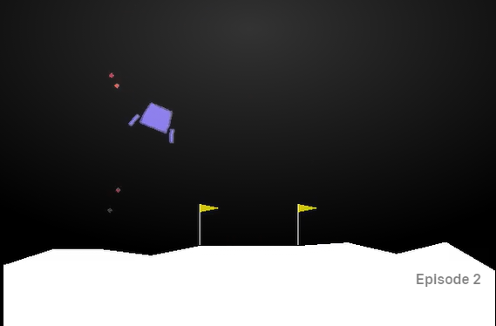
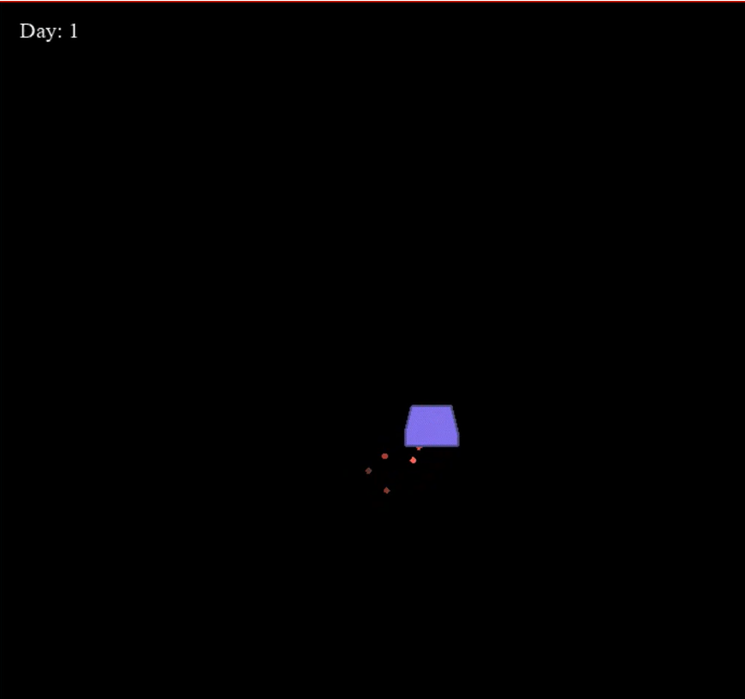

Training Environment (OpenAI Gym)
Adapted from Lunar Lander environment from OpenAI Gym
Constraints:
Environment limited to two dimensions
Time is discretized
+/- 0.05 degrees, in 2D translates to 73.6 km
Action space
10 elements: 3 different burn durations for 3 thrusters and do nothing
State space
7 elements: position, velocity, acceleration for both latitude and longitude and amount of fuel remaining
Notes:
Oliver

Slide 13
Approach
Episode
PPO Agent
Initialize PPO agent
2. Reward & transformed state
3. Action
Initializes OREKIT Propagator & Environment
1. Updated state
Propagator
Environment
4. Action
If State is terminal (e.g., outside of grid, out of fuel)
Reset Propagator
If State is terminal
(e.g., outside of grid, out of fuel)
Notes:
Brian
Now that we understand the Propagator, the PPO agent, and the environment we can put it all together:
First the PPO agent is initialized with all the key parameters
The PPO agent will initialize the OREKIT propagator and the Environment
This will then launch an episode:
First, the Propagator will send a state to the environment
The environment will determine the rewards that correspond to that state and transform the state into a form the Agent can understand, then it will send both to the PPO Agent
The PPO Agent will incorporate the rewards, then return an action to the environment that it thinks is appropriate for the given state
The environment will then send the action back to the propagator which will incorporate the action then update the state to the next time step
Then the loop repeats
However, what if the state that the propagator produces is out of the satellites bounds or indicates that the satellite is out of fuel
This is called a “terminal state”
The environment will recognize this, end the episode and reset the propagator to the initial conditions and a new episode is started
This process is then repeated hundreds of thousands of times as the agent learns more and more

Slide 14
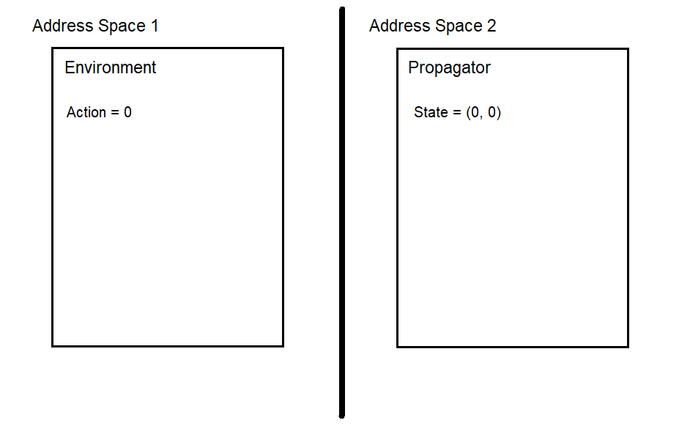
Integration
Multiprocessing, one process for environment and RL agent, one process for propagator
Propagation and training agent’s neural networks take the longest amount of time
Perform them simultaneously
Problems
Processes have separate address spaces and don’t share variables
Propagator and environment will be out of sync
Notes:
Oliver

Slide 15
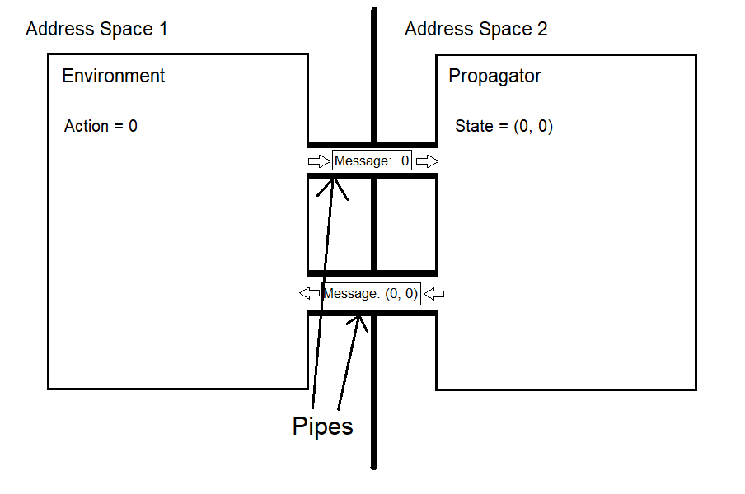
Integration
Pipes
Allow processes to communicate with each other by sending messages
Allow for synchronization of propagator and environment
Notes:
Oliver

Slide 16
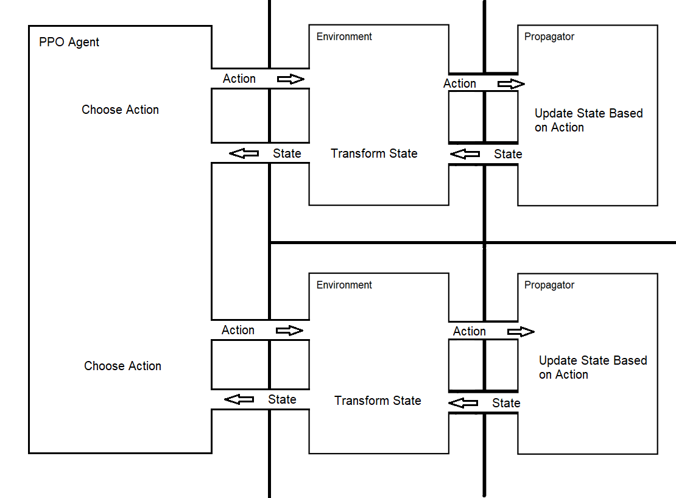
Run_multiprocesses()
PPO Agent is being trained on multiple environments at the same time, each one is independent of each other
Each environment has its own propagator
Each environment has its own training batch
All of the processes are working simultaneously

Slide 17
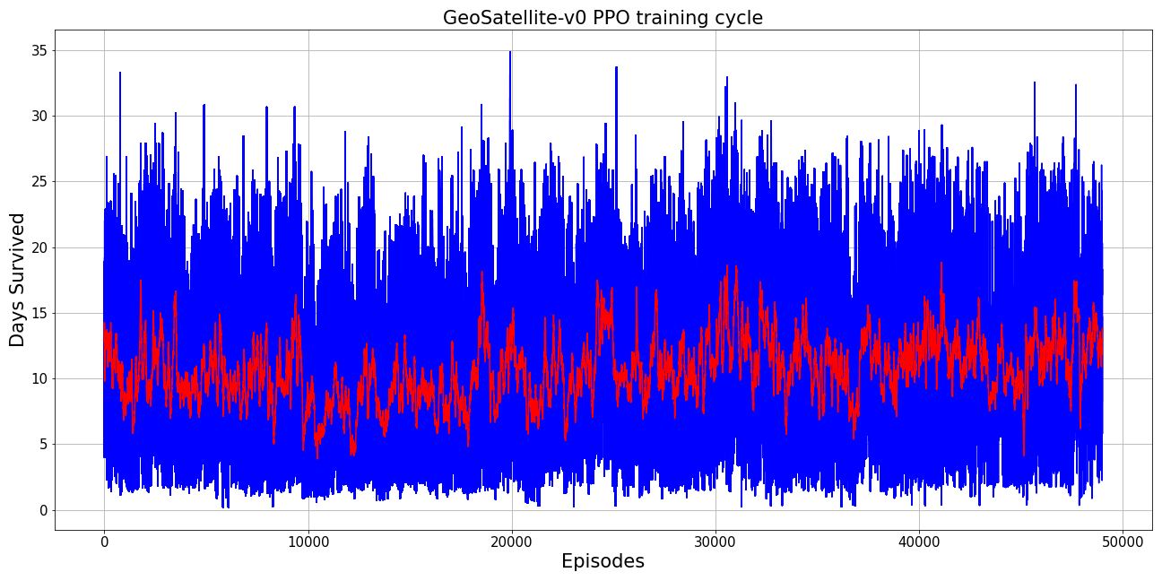
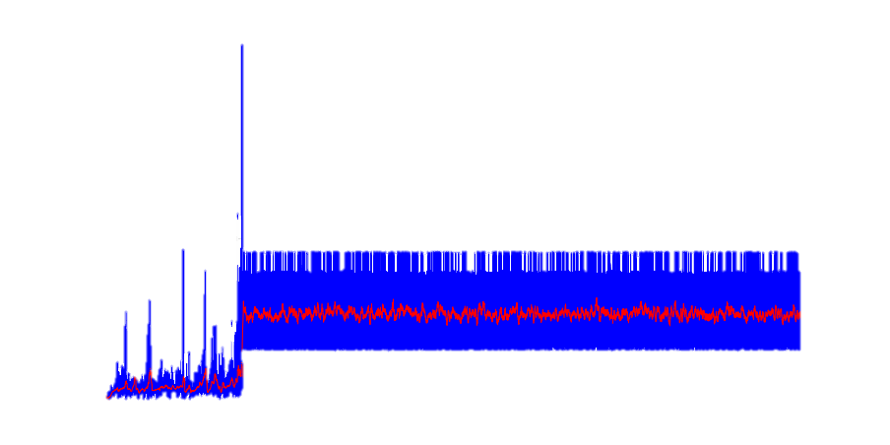
Challenges encountered
Integration of OREKIT with OpenAI Gym environment
Tuning
Slow iteration because of the computational requirements
Complexity
State space
Action space
Reward structure
Notes:
Oliver
- State/action spaces
- Moved from imperfect normalization to standardized state values
- Testing to identify optimal orbital elements
- Testing to identify optimal maneuver option set
- Reward structure
- Agent would exploit any local optima in the reward function

Slide 18
Complexity Tradeoffs
This project posed a unique challenge to balance complexity and effectiveness of the algorithm
Single Duration Thrust
Three Discrete Thrust Options Per Thruster
Continuous Duration Thrust
Action Space
Simple Complex
2D Position and Velocity
2D Position Velocity and Acceleration
Mean and Osculating Orbital Elements and Derivatives
State Space
Simple Complex
Simple Survival Reward
Diminishing Returns for Near Boundary Position + Fuel Penalty
Reward Structure
Simple Complex
Notes:
Brian
Mention that each thruster has 3 options
This project required balancing complexity (and the computational penalties that it entails) with the effectiveness of the algorithm
Action Space:
The complexity of the action space ranged from a single duration thrust for each thruster (for example 5 minutes) to a continuous distribution of duration for each thruster
A too simple action space risks the agent not having the necessary tools to survive while a too complex action space risks giving the agent unnecessary options
Through several tests of varying complexity, we chose to use three discrete burn time lengths for each thruster
State Space:
The complexity of the state space ranged from providing just 4 elements (X,Y position and velocity) to providing over a dozen elements of mean and osculating orbital elements and derivatives
A too simple state space risks the agent mistaking two different states as identical, while a too complex state space would require the agent to sift through significant amounts of useless or redundant information
Through several tests of varying complexity, we chose to use a 7 element state space of X,Y position velocity and acceleration and the remaining fuel
Reward Structure:
The reward structure complexity ranged from a simple reward for every time-step the satellite survives to offering diminishing returns as the satellite approaches the barrier and penalizing for fuel use
We found that diminishing returns appeared to have little effect, while a fuel penalty often resulted in the satellite choosing to never thrust
Therefore, the simplest reward structure of a reward for each time-step survived was chosen

Slide 19
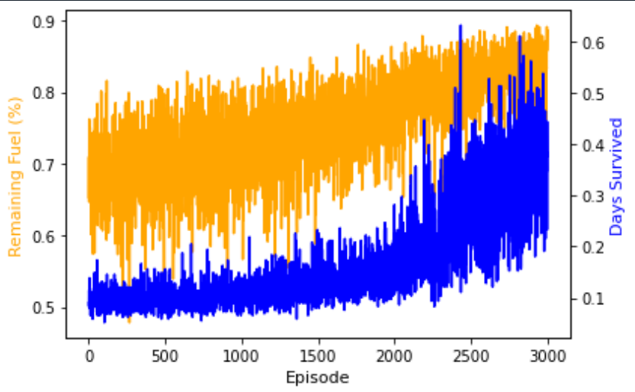
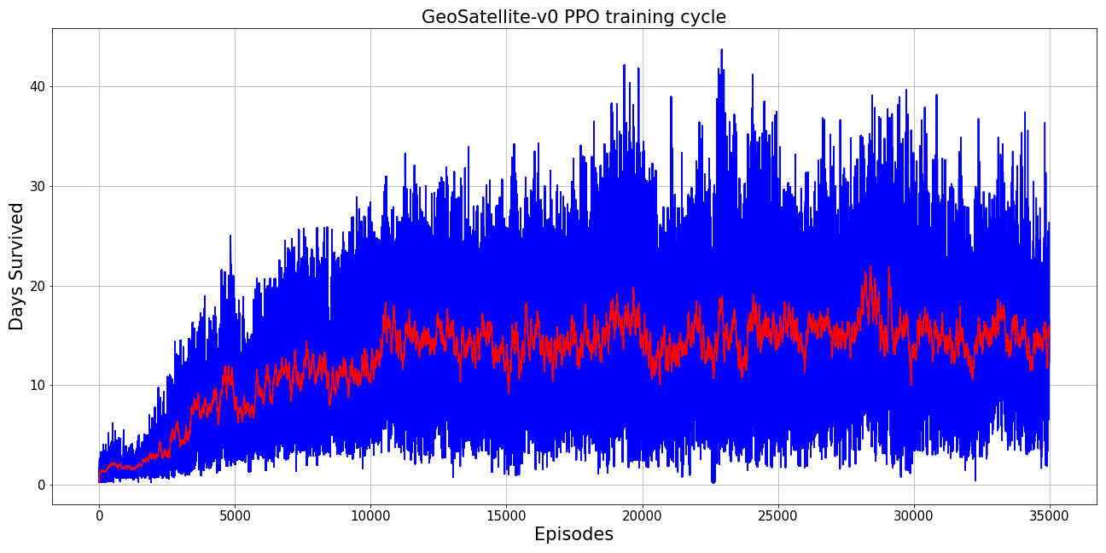
Final outputs
Graphs
Remaining Fuel and Days Survived vs Episodes
Days Survived vs Episodes
Key Metric
Longest survival time: ~52 days
Highest 50-episode moving average: ~22 days
Video of trained model

Slide 20
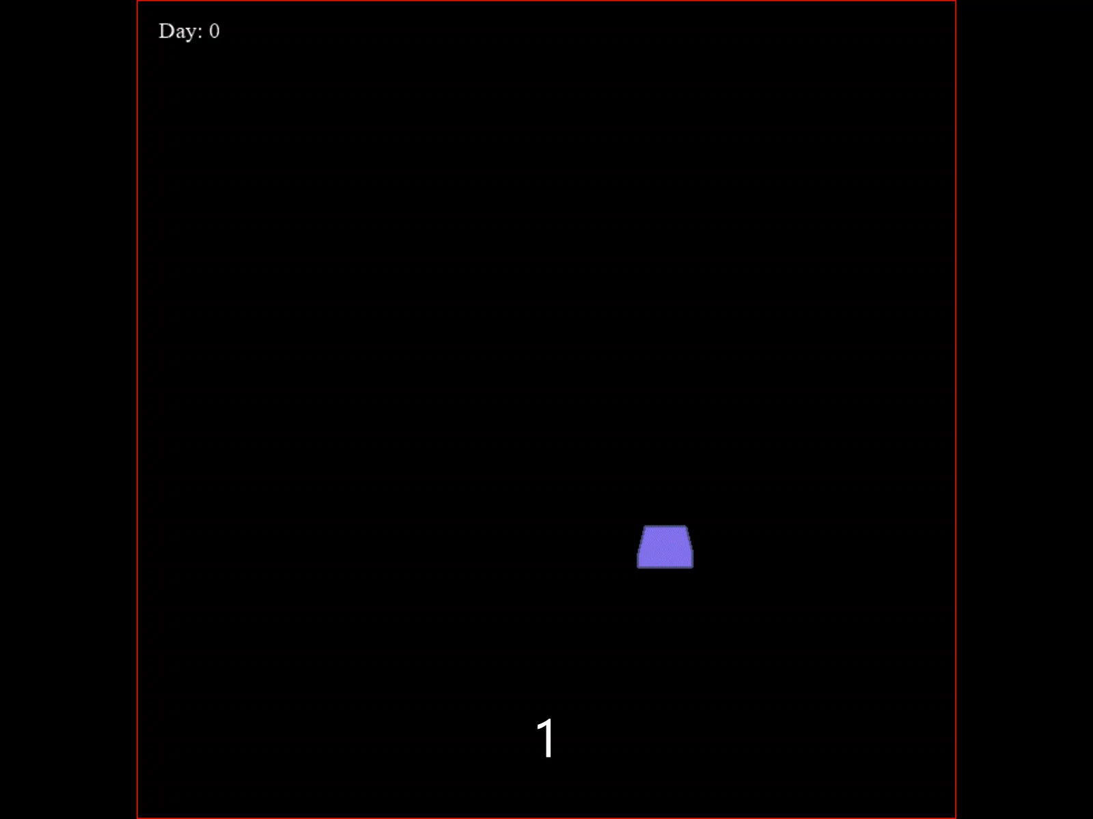
Future Outlook
The model has shown the capacity to learn life-extending maneuver strategies
Requires many training episodes; deep RL methods are very data hungry
Additional computational resources
Continued experimentation:
Varying the complexity of the action space (e.g., reduce to 4 elements, switch continuous)
Altering key model parameters
Applying other RL algorithms
Takeaway: There is encouraging progress towards the project goal, and success may be found with simply more time and small adjustments
Notes:
Erik
Parameters
Batch size: varied this to take into account the expected lifespan of the satellite
Discount factor: lowered the rate at which future rewards are discounted in order to accurately value longevity
Learning rate: variable learning rate that decreases as objective function progress is made in order to avoid losing a correct learning trajectory

Slide 21
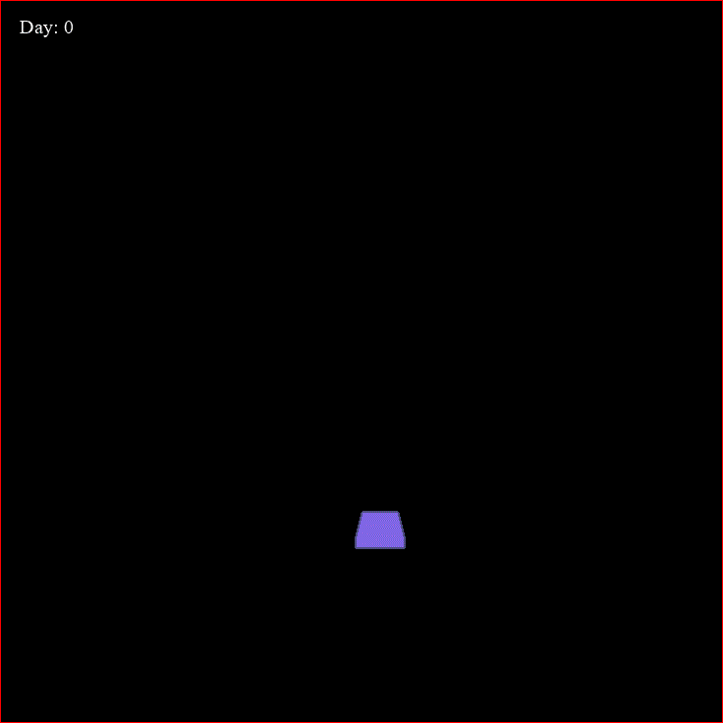
Questions?

Slide 22
Appendix

Slide 23
Sources
PPO Paper: https://arxiv.org/pdf/1707.06347.pdf
PPO Implementation: https://pylessons.com/LunarLander-v2-PPO/
OREKIT Propagation: https://gitlab.orekit.org/orekit-labs/python-wrapper/-/blob/master/examples/Propagation.ipynb
Geostationary Perturbations: Handbook of Geostationary Orbits, E. M. Soop

